Slide 1
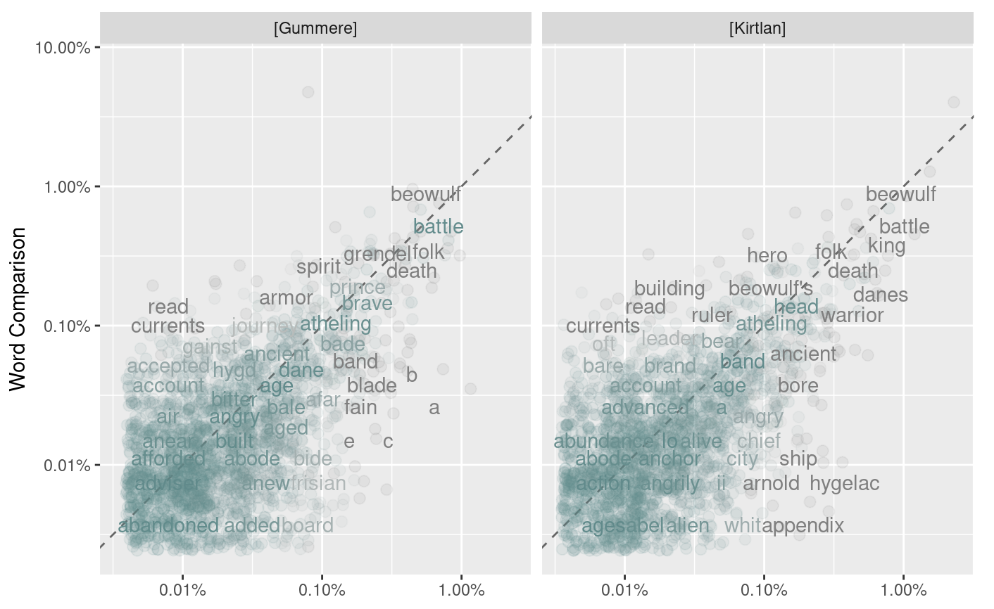
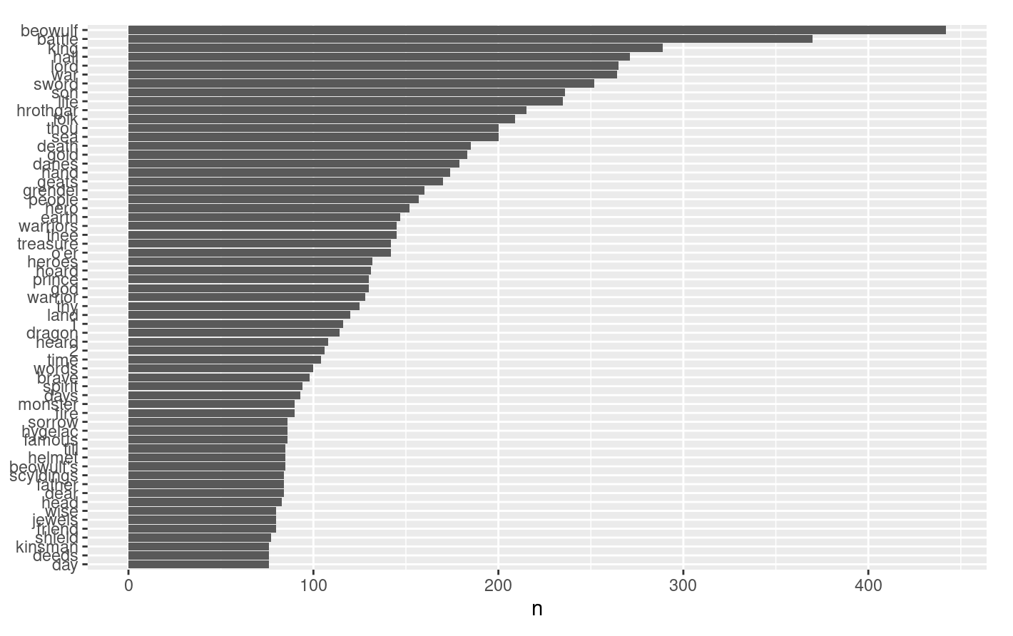

How Different is the Prose Between Translations of the Old English Epic Beowulf?
Using Project Gutenberg, three different translations were chosen.
Word frequencies between the three were then compared using R libraries.
The goal was to see if certain translators preferred to use certain words more than others.
Results were somewhat inconclusive, due to extra text outside the story, and the high amount of recurring nouns that appeared in all three translations.
I realized it would have been much better to simply look at full sentences side-by-side, rather than word frequency.

